Slide 1


CLICK2NET
Internet Service Provider Churn Analysis

Slide 2
TABLE OF CONTENTS
01
02
Background
Objective
03
04
EDA & Churn Predicted Model
Recomendations

Slide 3

Background

Slide 4

Industry Overview
The market in telecom / ISP company is fiercely competitive so that churn phenomena is one of biggest issue to ISP.
Some reasons to take churn seriously is that according to research from Invesp, it costs up 5X more to acquire a new customer than to keep an existing one. And existing customers are 50% more likely to try new products and spend 31% more, compared to new clients
Source : https://preseem.com/2023/01/turn-down-the-churn

Slide 5

Company Overview
Click2Net is one of Internet Service Provider. Click2Net offer several product or services, such as :
Internet only Package
Internet and TV Cable Package
Internet and Movie Package
Complete Package (Internet + TV Cable and Movie Package)
Two ways in which a customer could be using the services, One through a time-bound contract which costs less and another through a normal monthly subscription which obviously costs more.

Slide 6



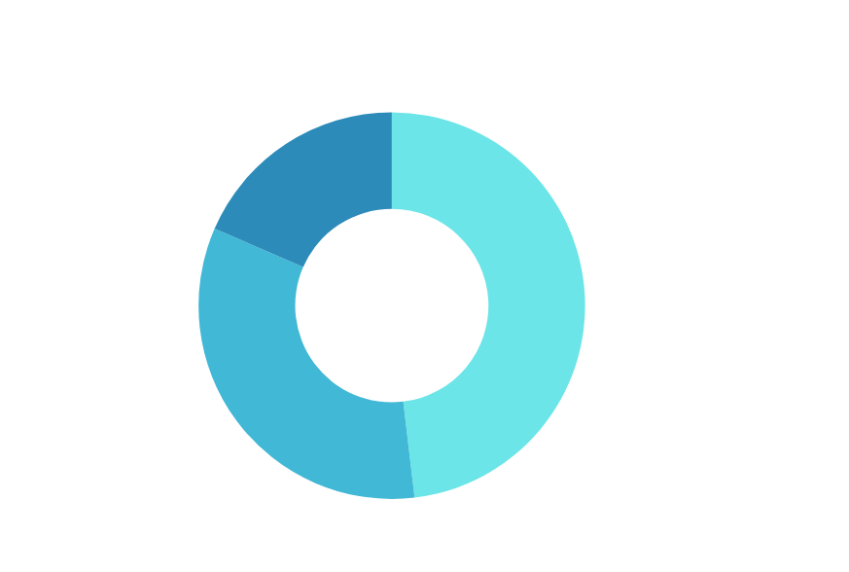



PERFORMANCE OVERVIEW
Non Contract User
Monthly Bill Avg
71.893 user
21.518 (30%)
19.02 USD
Donwload Avg Usage
Upload Avg Usage
44 GB / User
4. 19 GB / User
19. 819 Failure Service 40.050 (55%) User Churn

Slide 7

PROBLEM & GOAL

Slide 8

PROBLEM DEFINITION
From 71.893 user, 40.050 (55%) user are churn in last quarter
The data show that chun level of our company is higher compared to the average of ISP industry, Which the common churn level about 5% per month (15% per quarter)
Source : https://preseem.com/2023/01/turn-down-the-churn

Slide 9

OBJECTIVE
How to reduce the churn from 55% to 35% by next year?
By analyze profile or behavior of the customer that more likely to churn and create churn probability model so we are able to predict whether the customer will churn or not

Slide 10


METHODOLOGY
DATA GATHERING
DATA CLEANING
DATA ANALYSIS
INSIGHT & RECOMENDATION
Data gathering from Kaggle
Data Cleaning and Manipulating using Ms. Excel
EDA using Ms. Excel and Tableau
Creat Churn Probability Model using Phyton
Provide recomendation from data analysis
Original Dataset Link
Cleaned Dataset Link
Churn Model : Phyton syntax Link
Final Dashboad Link

Slide 11

EXPLORATORY DATA ANALYSIS

Slide 12
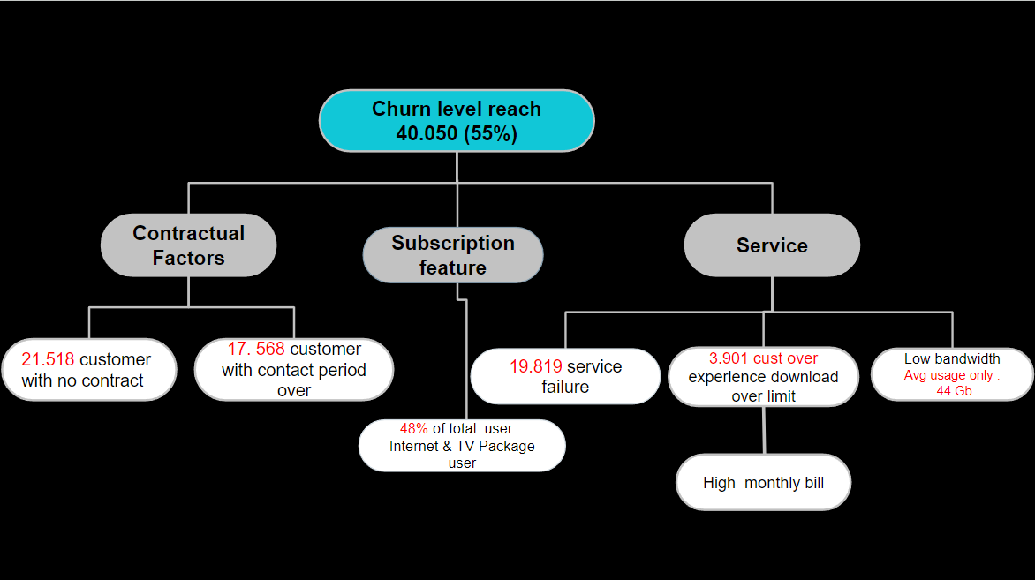
ROOT CAUSE ANALYSIS

Slide 13

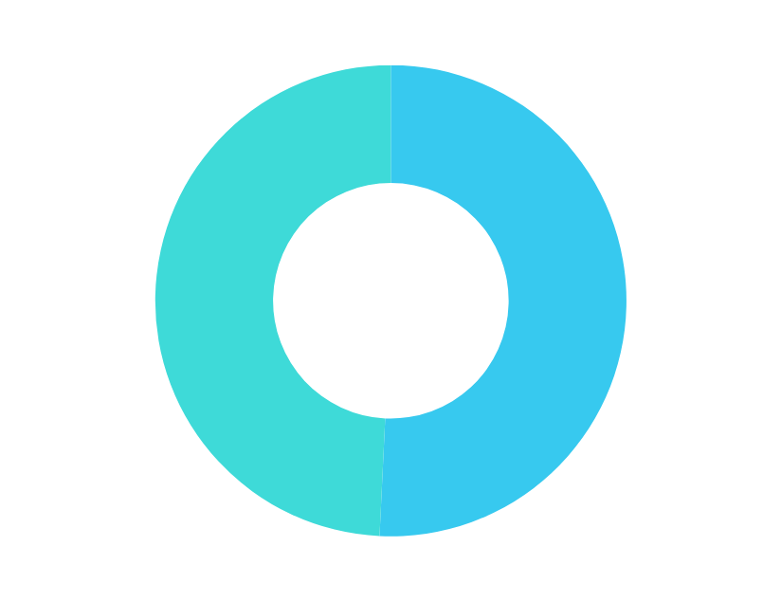
19. 719 (49,2%) Churn Customer : Customer that didn’t sign any contract / Monthly subcription customer
20. 331
20.331
(40%)
Churn Cust
based on contract
Number of Cust
19. 719)
19. 719
(92%)
1.799
30.044
Is Contract?
From the bar chart, we can see that the percentage of churn for customers who have contract is less than customers who have not signed contract ( 40% vs 92%)
Having contract has significant impact to churn level

Slide 14

16. 822 (96%) Costumers whose contract period over decided to churn and contributes 42% to all churn customer
3.509 (11%)
There is 3.509 (11%) Customer that the remaining contract is left > 1 month but they canceled their service before contract time end t﻿hen pay a penalty fare.
Number of Cust
16.822
(96%)
746
Remaining contract has significant impact to churn level
Remaining Contract (Month)

Slide 15
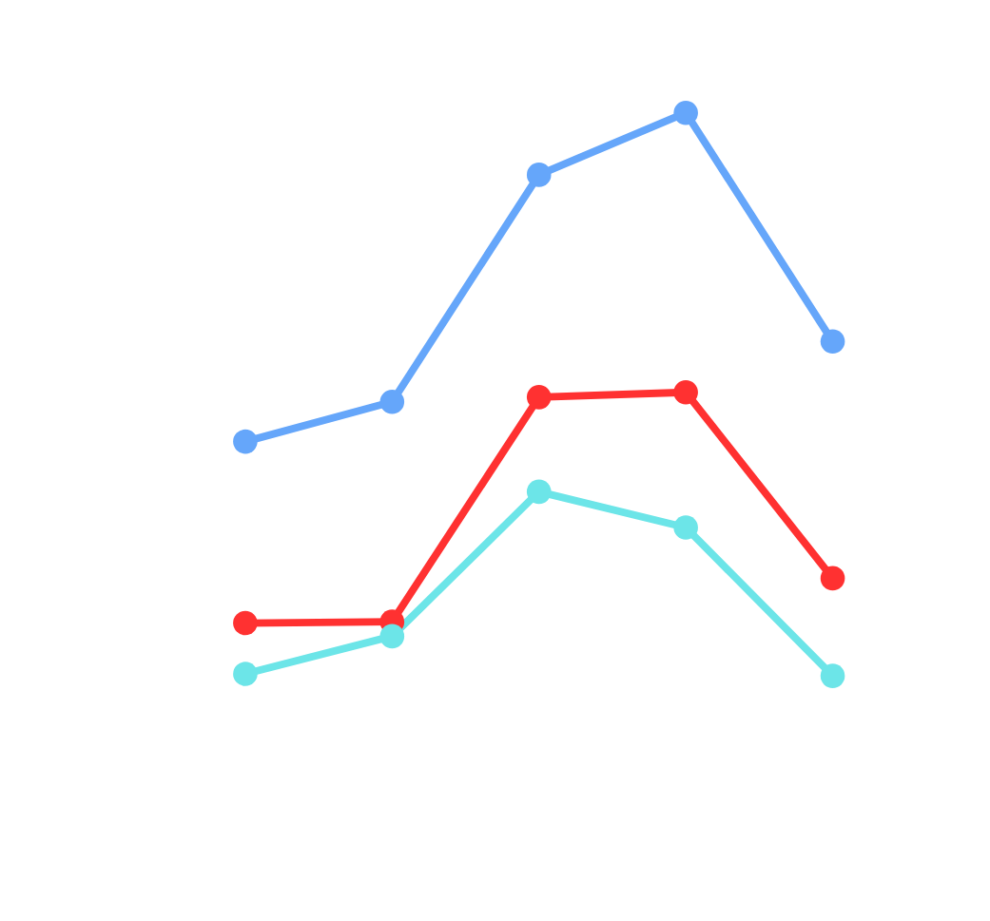
23. 158 (52%) Churn Customer : Customer with MOB between 1 - 4 years (Old customer)
19. 454
11.511
All customer
Our Customer dominated by old customers 37.177 (52%), with MOB between 1 - 4 years.
It indicates that our customer mostly opted
1 - 2 yearly contract
Most customers do not renew their contracts when the contract over
11.511
11.647
Number of Cust
8.870
7.870
All Curn customer
Churn Chustomer with remaining contract 0
MOB (Month)

Slide 16

19.891 (47%) Churn Customer : Customer that subscribe Internet & TV Cable
34.594
19.891
(57%)
Internet & TV Cable package contributes (47%) to churn
In other hand Internet only packacge customer has the highest churn level conversion (90%) compared to the other type of service
11.511
(30%)
24.015
13.282
11. 964
(90%)
Subscription type has significant impact to
churn level
Number of Cust

Slide 17


6.686 (17%) Churn Customer : Customer that experience failure service
33.364
Number of Churn Cust
6.686 (17%)
The Failure service does not have a significant impact on churn
Failure Service Count

Slide 18

3.451 (9%) Churn Customer : Customer that experience Download Over Limit
36. 599
3.451
Number of churn Cust
Download over limit does not have a significant impact on churn
Download Over Limit (GB)

Slide 19


Both Download and Upload Avg Speed of Churn user is less then average of Not Churn User
Download Avg (GB)
Upload Avg (GB)
65
6
Download and upload speed have an impact on churn
3
27

Slide 20

Non Churn Customer has higher Average Monthly bill
19,4
18,7
Average Monthly Bill (USD)
The Monthly bill does not have an impact on churn

Slide 21
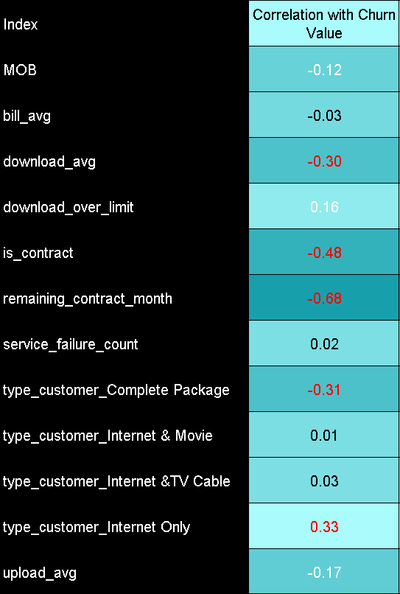
Correlation Analysis
Strong or Significant Correlation with Chun Value
Is_Contract
Remaining Contract
Moderate Correlation with Chun Value
Download_avg
Type Customer (Internet_Only and Complete Package)

Slide 22
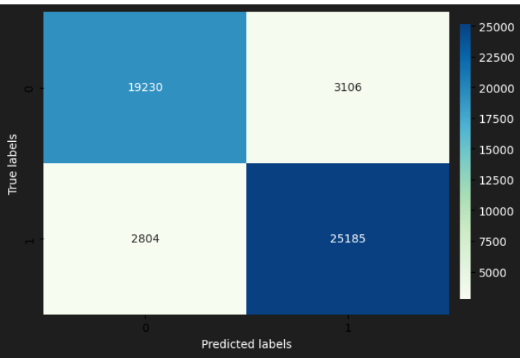
Churn Modeling : “ What is Predicted Churn Rate”
Predictive Modeling Using Logistic Regression
Model built from our existing data with comparison 70 : 30
0
Avg Churn Probability : 53%
Avg Churn Probability Churner : 80%
Avg Churn Probability non- Churner : 20%
1
0
1
Model Accuracy: 88%
If we do nothing, up to 20% Customer may Churn and raised our existing churn level

Slide 23
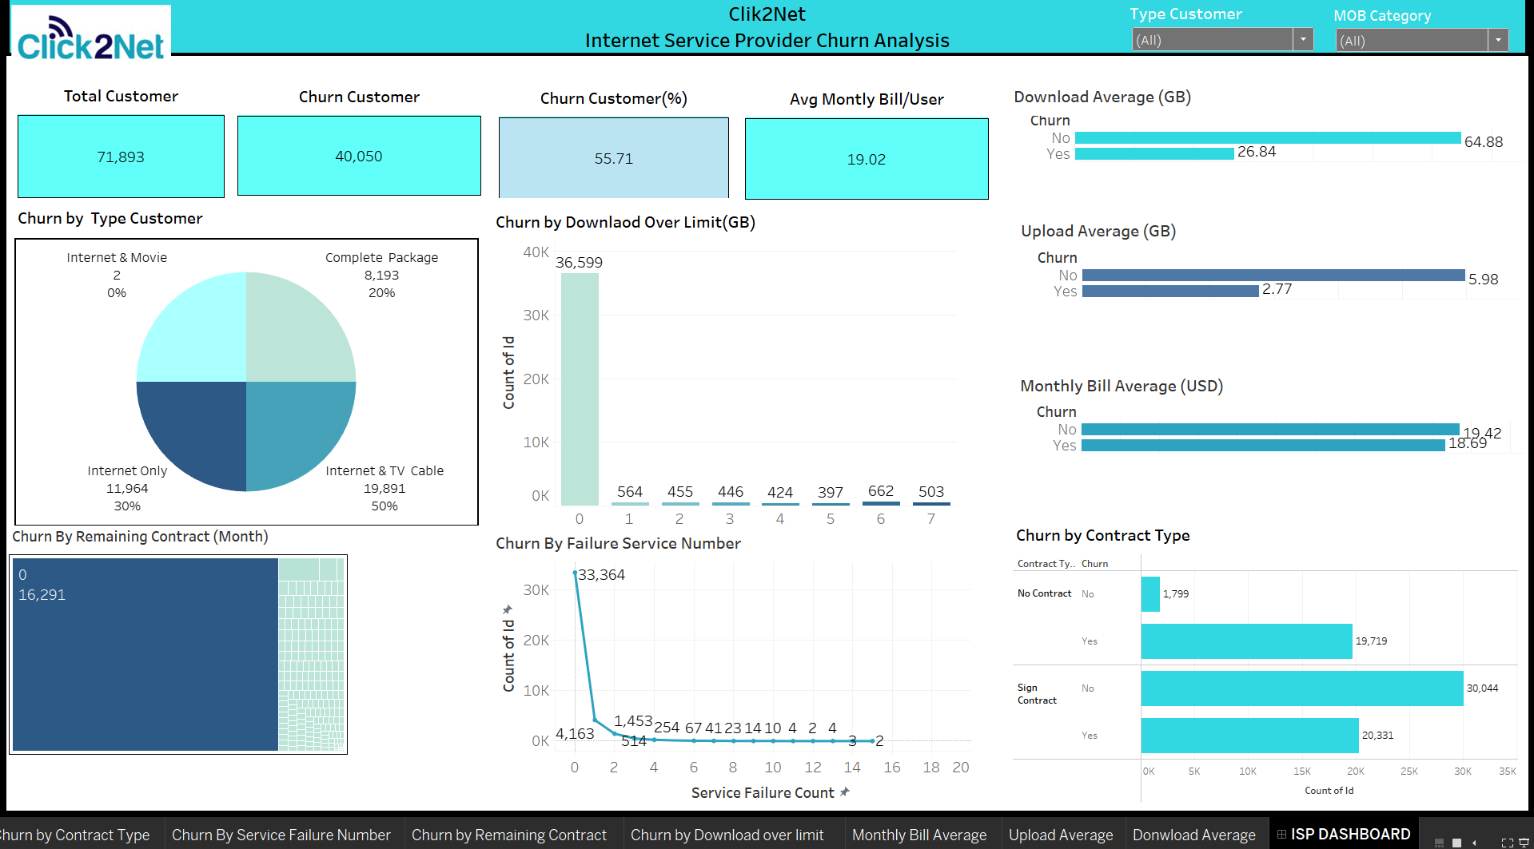
Tableau Dashboard
Tableau Link

Slide 24

Insight Summary &
Recomendations

Slide 25
Insight Summary
According to the exploratory data analysis, the following factors were found to have a significant impact on churn:
Contractual Factors: Customers who didn't sign any contract or had monthly subscriptions had a higher churn rate compared to those with contracts
Remaining Contract Period: Customers whose contract period ended decided to churn, contributing significantly to the overall churn rate
Service Type : The Internet & TV Cable package had a significant churn rate contribution, while Internet-only package customers had the highest churn level conversion
Bandwidth : it was found that churned customers had lower average download and upload speeds compared to non-churned customers

Slide 26
Recomendations
To achieve the objective of reducing churn from 55% to 35%, Click2Net can implement targeted marketing campaigns focusing on the following strategies:
Long-Term Contract Incentives: Launch a marketing campaign promoting the benefits of signing longer-term contracts, such as discounted monthly rates, additional services, or loyalty rewards. This can encourage customers to commit to longer contracts
Improved Internet Packages Promotion: Promote the complete package through targeted advertising, special deals, and personalized offers to attract more customers to opt for this comprehensive package.
Bandwidth and Speed Enhancements : Upgrades and improve our infrastructure in download speed and bandwidth then comunicate through marketing materials, emphasizing the enhanced internet experience for customers. This can help in retaining existing customers and attracting new ones

Slide 27



Slide 28
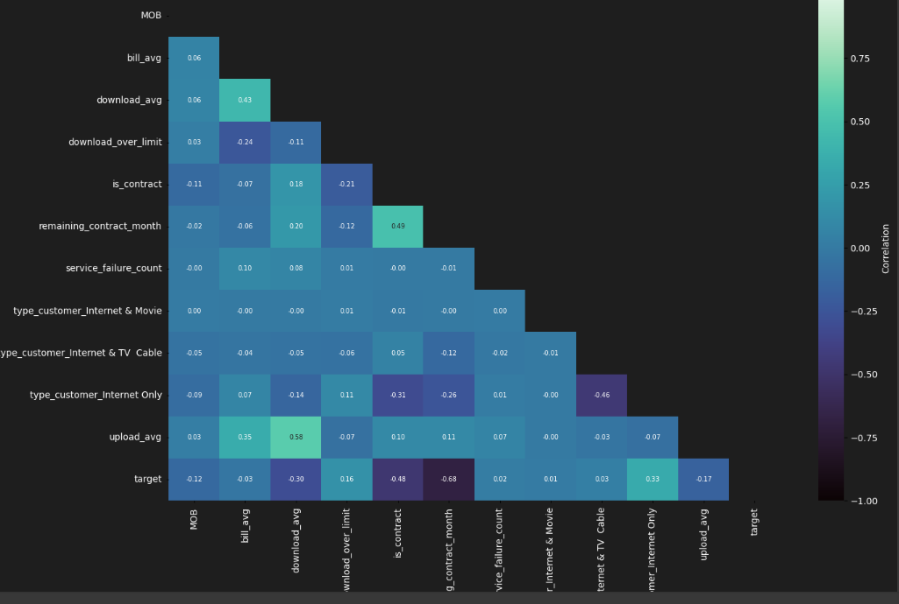
Correlation Analysis
Phyton Link

Slide 29
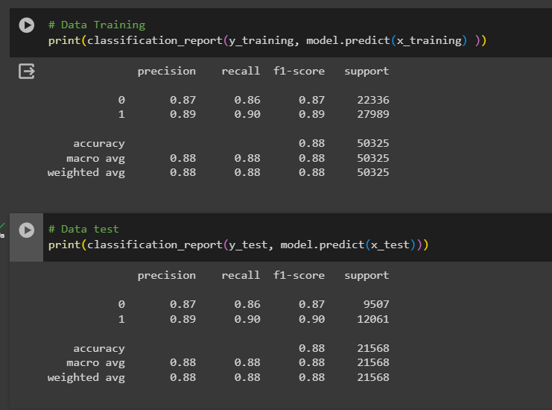
Model Evaluation
Phyton Link

